Slide 1

Web Scraping Project

Slide 2
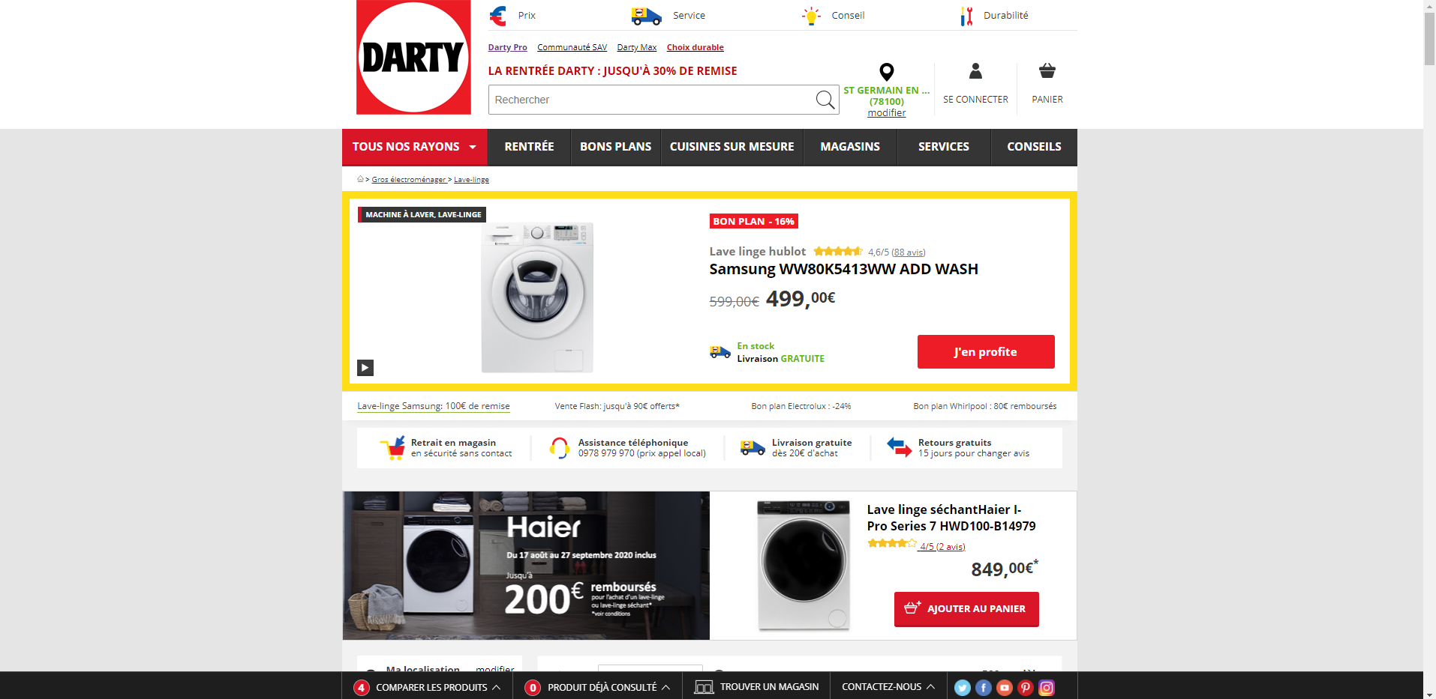

Slide 3

Hipothetical case

Slide 4
Hipothetical Case
Darty wants an analysis on the following points:
The best rated washing machines;
The brands with most washing machines out of stock
The price range of their catalog;
The brands with the highest and lowest number of washing machines on sale.

Slide 5
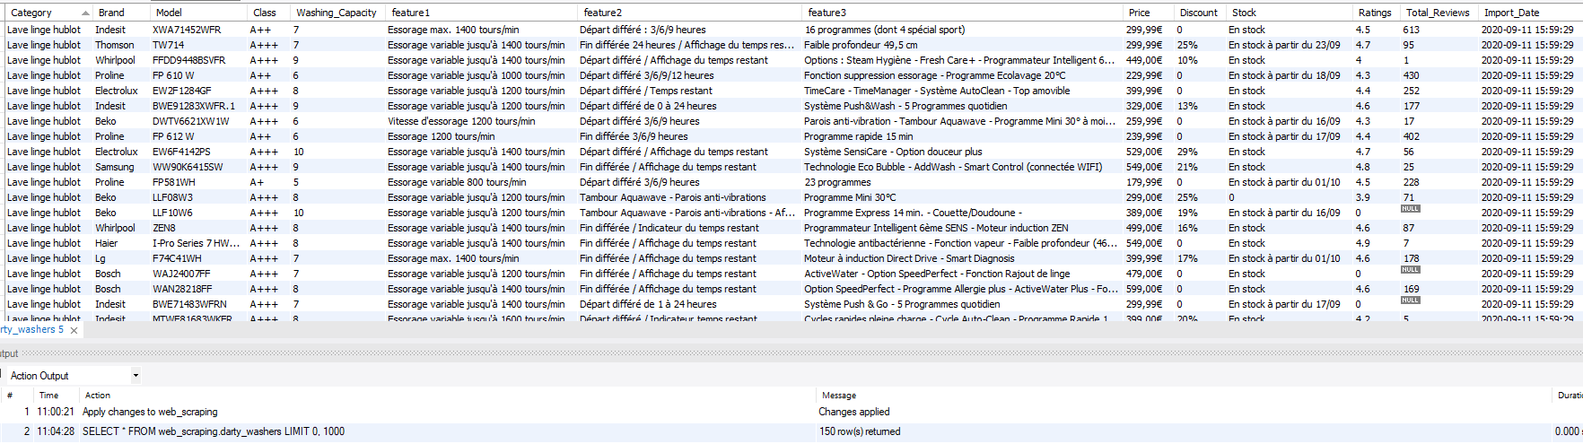
Output

Slide 6

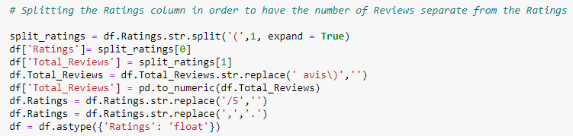
Data Cleaning Steps
Separate the ratings from the number of Reviews

Slide 7
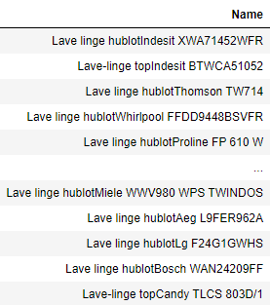
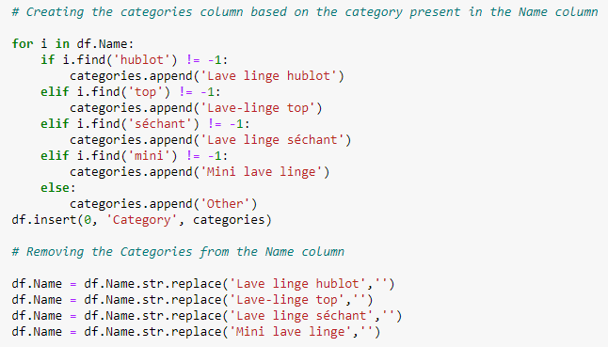
Data Cleaning Steps
Separate the category from the brand and the model

Slide 8
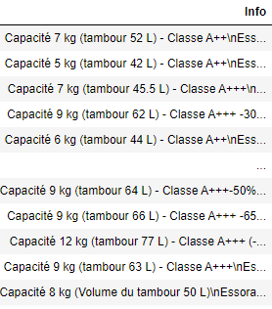
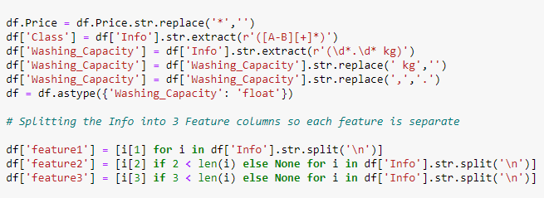
Data Cleaning Steps
Create the Class and Washing Capacity columns, as well as the features columns

Slide 9
Data Potential
Price Binnings;
Correlations between the number of reviews and the prices;
Calculate average discount applied to the products and check the impact on the number of reviews and stock;

Slide 10
What I have learned
What I would have done differently
Found new ways to web scrape;
Discovered new functions to help with data cleaning;
Data cleaning is, indeed, the stage that takes most of the time in whole process;
Chosen another webpage, with more data;
Visualize and write down the final output before starting to code
Web Scrape each piece of information from the start

